Slide 1

React Refactoring and Best Practices
Notes:
Hello everyone, today I am gonna talk about React Component Refactoring.
Think of it as renovating a house – we're not tearing down the whole structure but enhancing
it to make it more functional and aesthetically pleasing, improveing the quality, maintainability,
and scalability of our React applications.
Let's get started!

Slide 2
React Component Refactoring
1
Identify Responsibilities
Break down the component into smaller logical parts. This helps in clear separation of concerns and makes the codebase more modular.
2
Separate Concerns
Ensure each component focuses on a single responsibility. This improves the maintainability and reusability of the code.
3
Extract Components
Extract reusable components from the existing code. This promotes code reuse and reduces duplication.
4
Reduce Complexity
Simplify the code to make it easier to understand and maintain. This improves the overall readability and reduces the chances of bugs.
5
Reuse Code
Use existing components to avoid duplicating code. This saves development time and ensures consistency.
6
Improve Readability
Make the code more readable and easier to follow. This helps in better collaboration and understanding among team members.

Slide 3
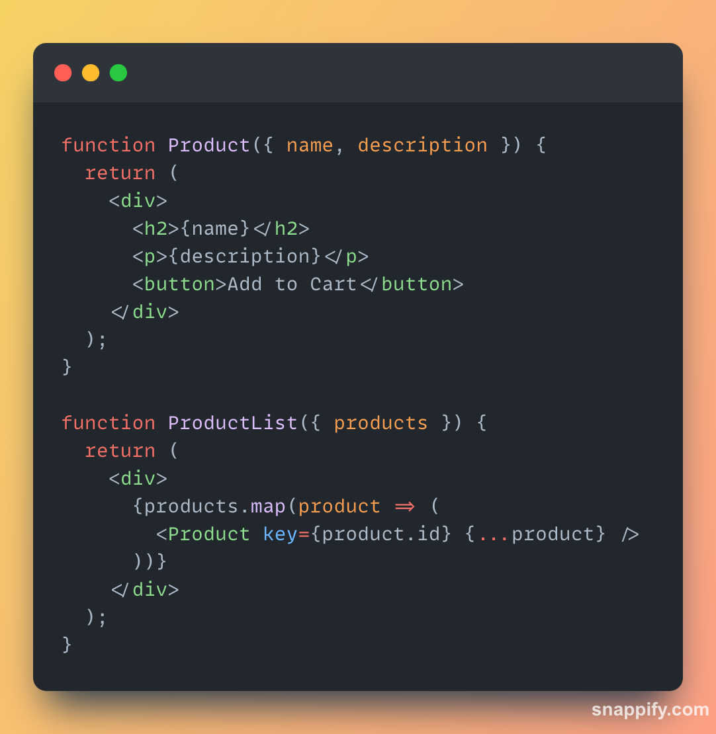
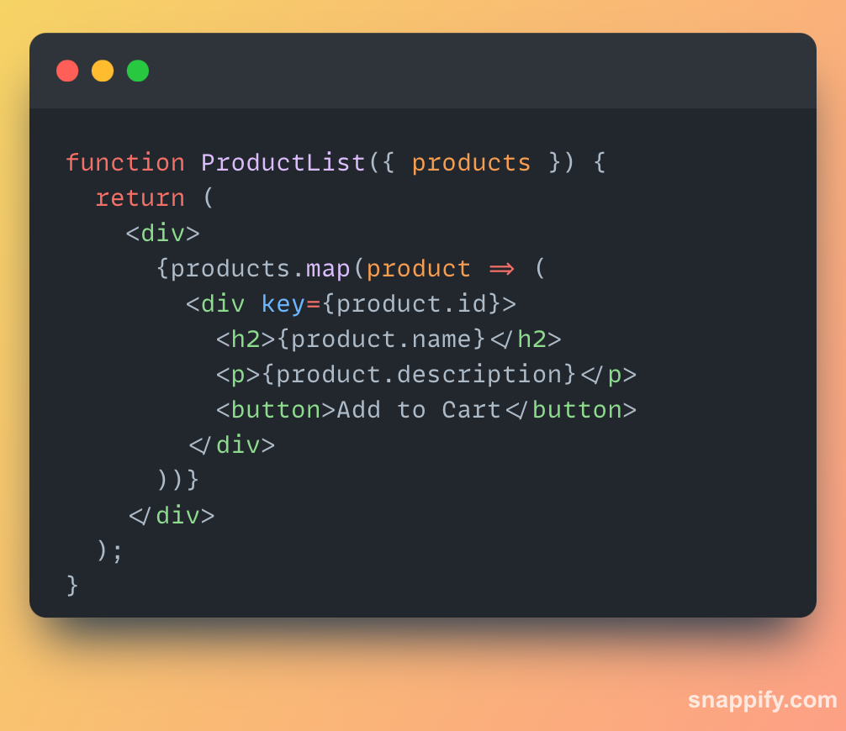
Identify Responsibilities
Notes:
Before we roll up our sleeves, we need to understand what each component is responsible for.
By breaking down our components into smaller, logical parts, we ensure that each piece has a clear role to play.
This separation of concerns promotes modularity within our codebase, making it easier to understand and maintain.

Slide 4
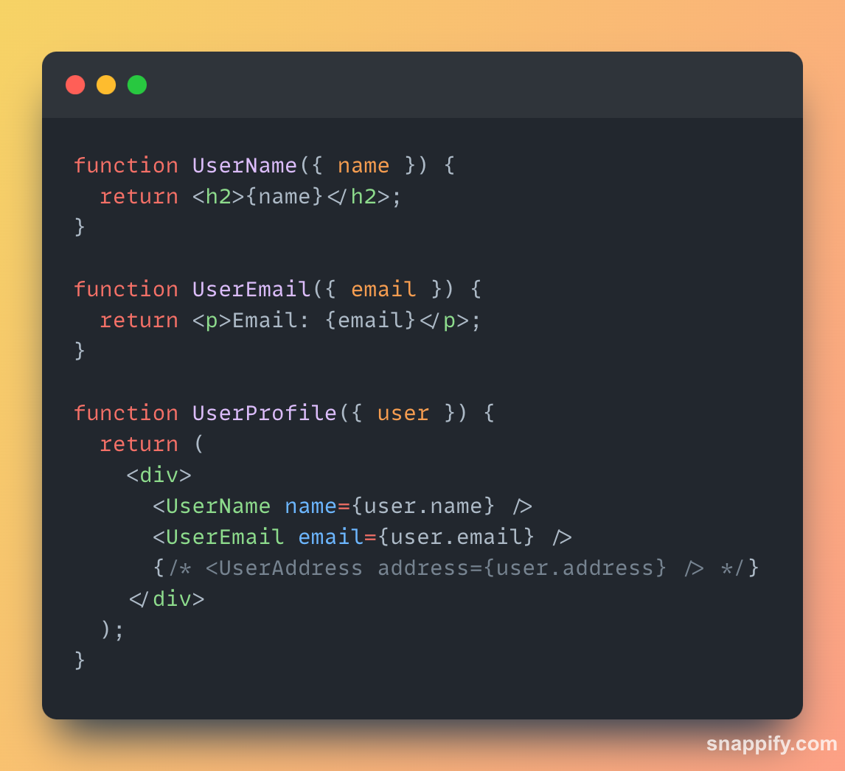
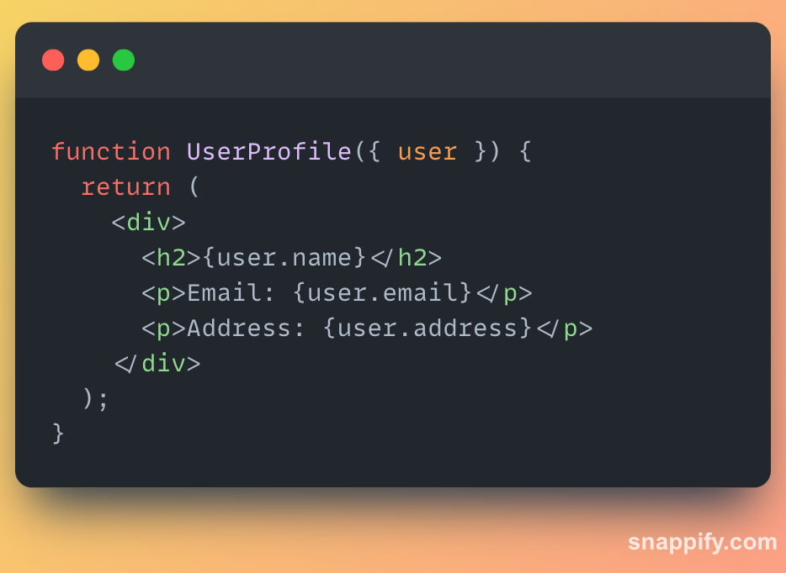
Separate Concerns
Notes:
Once we've identified responsibilities, our next step is to ensure
that each component focuses on a single responsibility.
This principle of single responsibility is like organizing a toolbox – each tool has its purpose,
making our codebase cleaner and more efficient. This approach enhances
maintainability and reusability by reducing complexity.

Slide 5
Extract Components
Notes:
Now, let's talk about reusability. We want to extract reusable components
from our existing code whenever possible. This not only reduces duplication
but also promotes a more modular architecture. By creating reusable components,
we can build our applications more efficiently and make maintenance easier down the road.

Slide 6
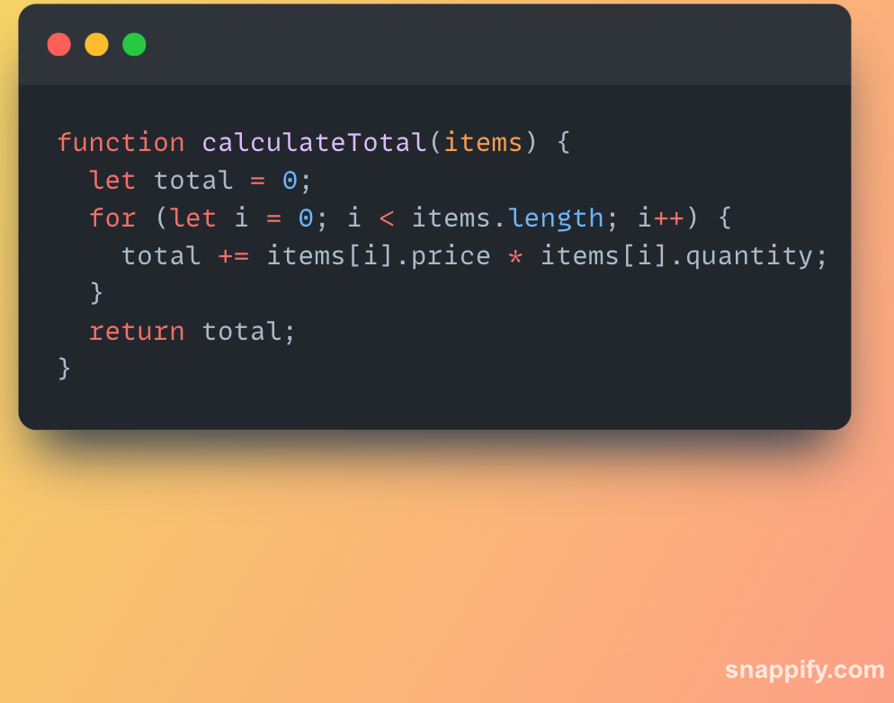
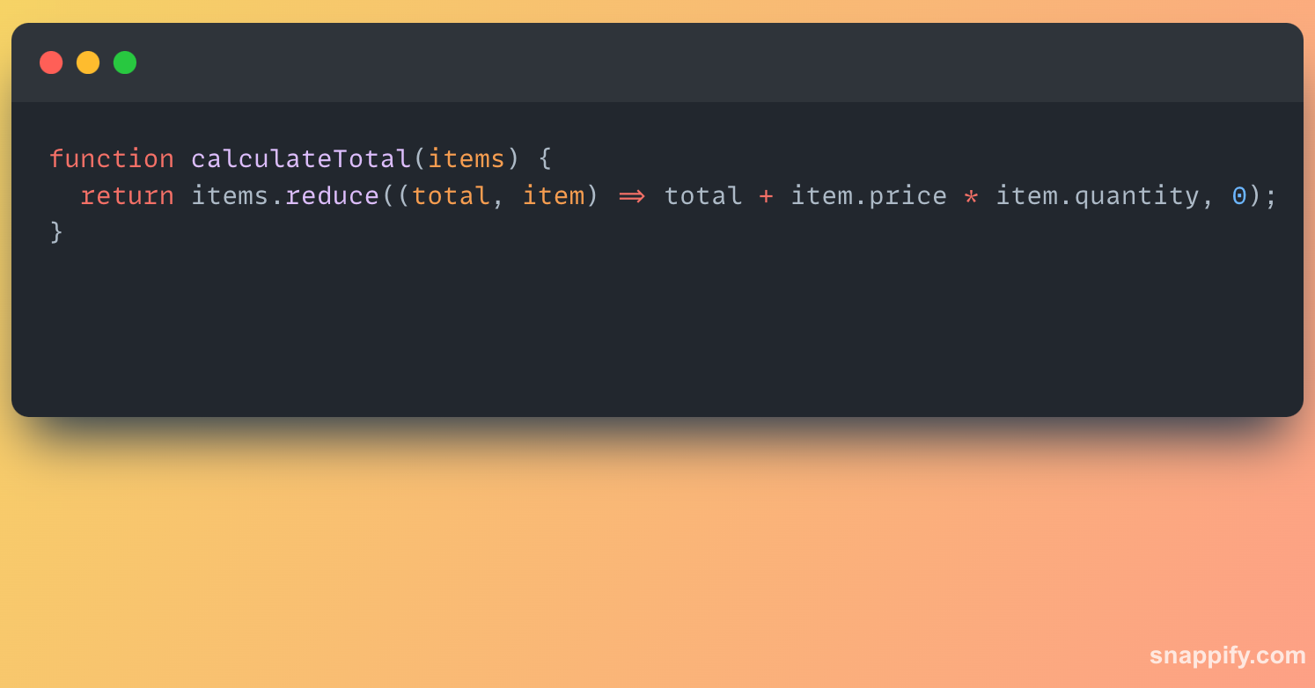
Reduce Complexity
Notes:
Complexity is the nemesis of maintainability. Our goal is to simplify the codebase
wherever we can. By eliminating unnecessary abstractions and optimizing our logic,
we make our code easier to understand and maintain.
This reduction in complexity reduces the chances of bugs creeping into our code
and makes future enhancements smoother.

Slide 7
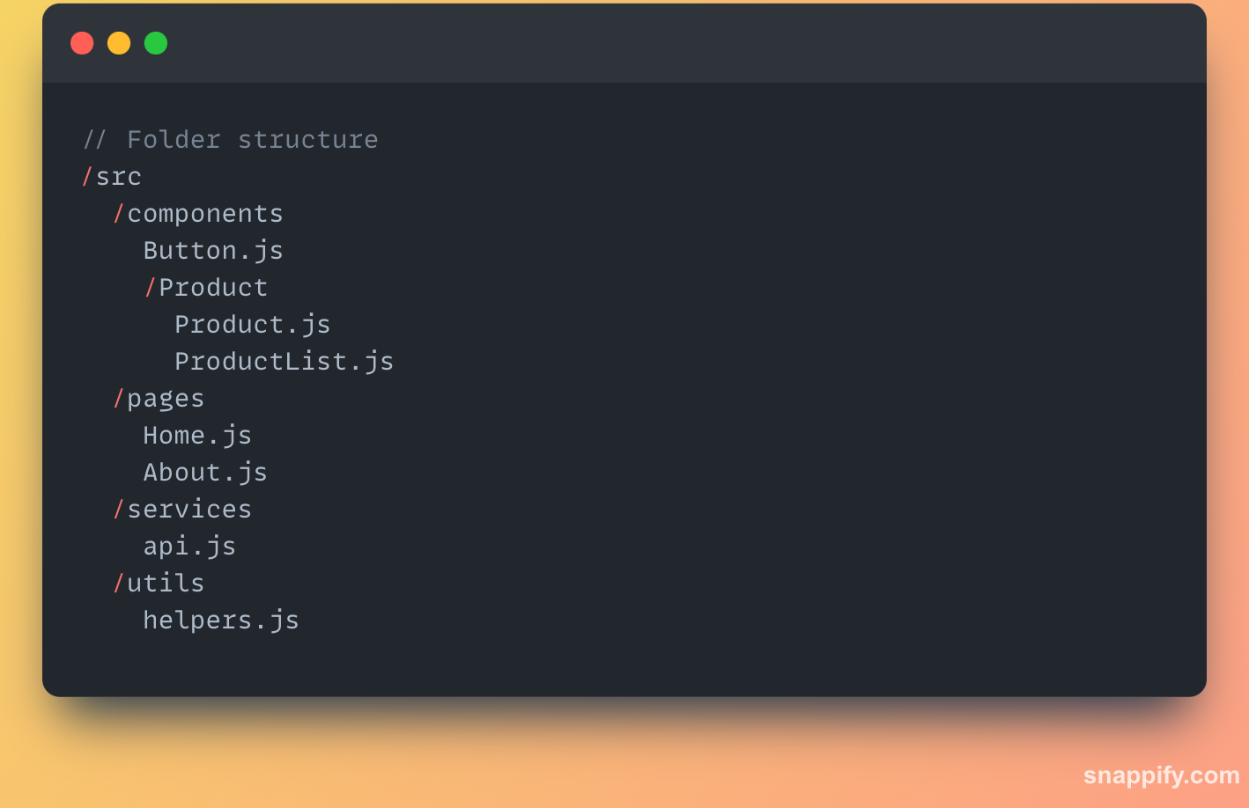
Improve Readability
Notes:
Clear, readable code is essential for effective collaboration.
Let's focus on making our code more readable and easier to follow.
By following coding conventions and using descriptive comments,
we can ensure that our codebase is accessible to everyone on the team.
This improves collaboration and understanding, leading to a more efficient development process.

Slide 8
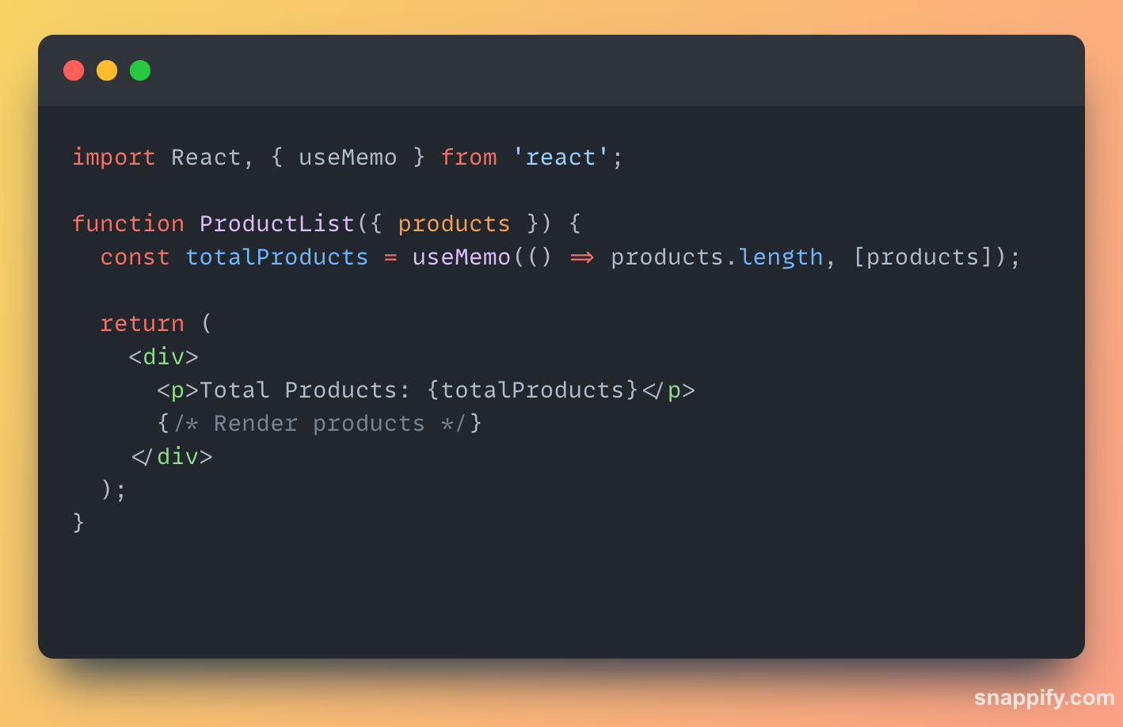
Performance Optimization
Notes:
Performance is key in web development. Let's explore some techniques for optimizing our React applications.
Memoization techniques like React.memo and useMemo help us avoid unnecessary re-renders,
improving performance. Implementing code splitting and lazy loading reduces initial loading time, e
nhancing the user experience.

Slide 9
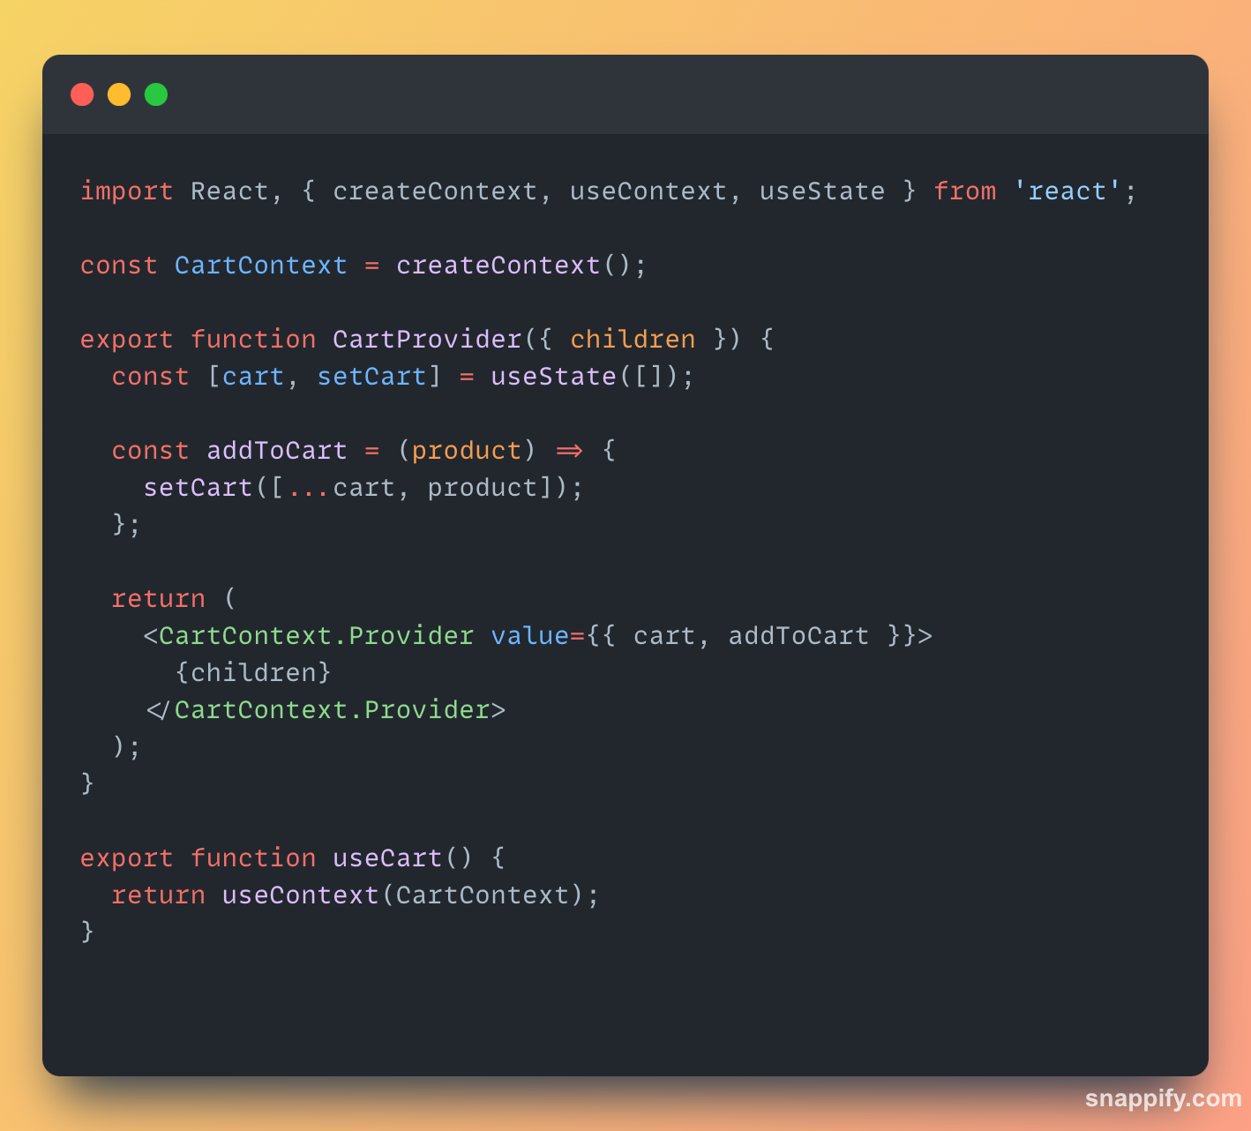
State Management
Notes:
State management is a fundamental aspect of React development.
Let's look at some options for managing state effectively. React's Context API provides
a centralized and scalable solution for managing global application state.
Redux offers a structured approach with a unidirectional data flow, while MobX provides a more reactive alternative with observable state.

Slide 10
State Management
React Context API
Redux
Utilize React's Context API to manage global application state in a centralized and scalable way, avoiding manual prop passing between distant components.
Adopt the Redux library for a more structured approach to state management, with a unidirectional data flow and a single source of truth.
MobX
Hooks
Consider using the MobX library for a more reactive approach to state management, with a concise syntax and an observable state model.
Take advantage of React Hooks, such as useState and useReducer, to manage state in a simpler and more readable way in functional components.
Notes:
State management is a fundamental aspect of React development.
Let's look at some options for managing state effectively. React's Context API provides
a centralized and scalable solution for managing global application state.
Redux offers a structured approach with a unidirectional data flow, while MobX provides a more reactive alternative with observable state.

Slide 11




Unit and Integration Testing
Unit Testing
Integration Testing
Snapshot Testing
React Testing Library
Implement unit tests to ensure the proper functioning of individual components and functions, facilitating refactoring and regression detection.
Use snapshot tests to compare the visual representation of components with previous versions, detecting unexpected changes in the interface.
Perform integration tests to verify the correct functioning of the application as a whole, validating the interaction between different components.
Adopt the React Testing Library to write tests focused on user experience, rather than internal implementations, making refactoring easier.
Notes:
Testing is crucial for ensuring the reliability of our applications. Let's discuss testing strategies for our React components. Unit tests verify the individual components and functions, facilitating refactoring and regression detection. Integration tests validate the interaction between different components, ensuring that our application functions as expected as a whole.

Slide 12
Code Structuring Best Practices
1
Folder Organization
2
Descriptive Naming
Adopt a consistent and scalable folder structure, grouping components, pages, services, and utilities logically to facilitate project navigation and understanding.
Use descriptive file and component names that clearly express their function, avoiding generic names or abbreviations.
3
Separation of Concerns
4
Code Reusability
Maintain a clear separation between business logic, visual presentation, and state management, following the principles of single responsibility and separation of concerns.
Identify and extract reusable components and functionalities, avoiding code duplication and facilitating project maintenance and evolution.

Slide 13



Performance Optimization
Memoization
Code Splitting
Lazy Loading
Utilize memoization techniques, such as React.memo and useMemo, to avoid unnecessary re-rendering of components, improving the overall performance of the application.
Implement code splitting by dividing the application code into smaller chunks that can be loaded on demand, reducing the initial loading time.
Adopt the lazy loading technique by loading components and resources only when needed, optimizing bandwidth usage and improving the user experience.
Notes:
Performance is key in web development. Let's explore some techniques for optimizing our React applications.
Memoization techniques like React.memo and useMemo help us avoid unnecessary re-renders,
improving performance. Implementing code splitting and lazy loading reduces initial loading time, e
nhancing the user experience.

Slide 14
Conclusion and Next Steps
Notes:
To summarize, React Component Refactoring is much more than code optimization,
it is about creating and reinforcing a culture of continuous improvement
and craftsmanship inside the development team, carefully following the steps above,
developers can improve the code quality, maintainability, and scalability of their React applications
and therefore be well-equipped to stand on solid ground for sustainable growth and innovation. And
As React develops, and new trends appear, the developers must stay aware and try new approachesl

